Slide 1
2.4. Unsupervised Learning
Unsupervised Learning & its Types

Slide 2







Unsupervised Learning
Unsupervised Learning deals with unlabeled data. The system tries to identify hidden patterns or structures in the data without knowing the correct answers.
Customer Segmentation
Market Basket Analysis
Gene Clustering in Biology

Slide 3





Types of Supervised Learning
01
02
Clustering
Association
Grouping similar data points based on features without any labels.For example: grouping customers based on purchasing behavior.
Discovering interesting relationships or rules among variables.For example: “People who buy bread often buy butter.”

Slide 4
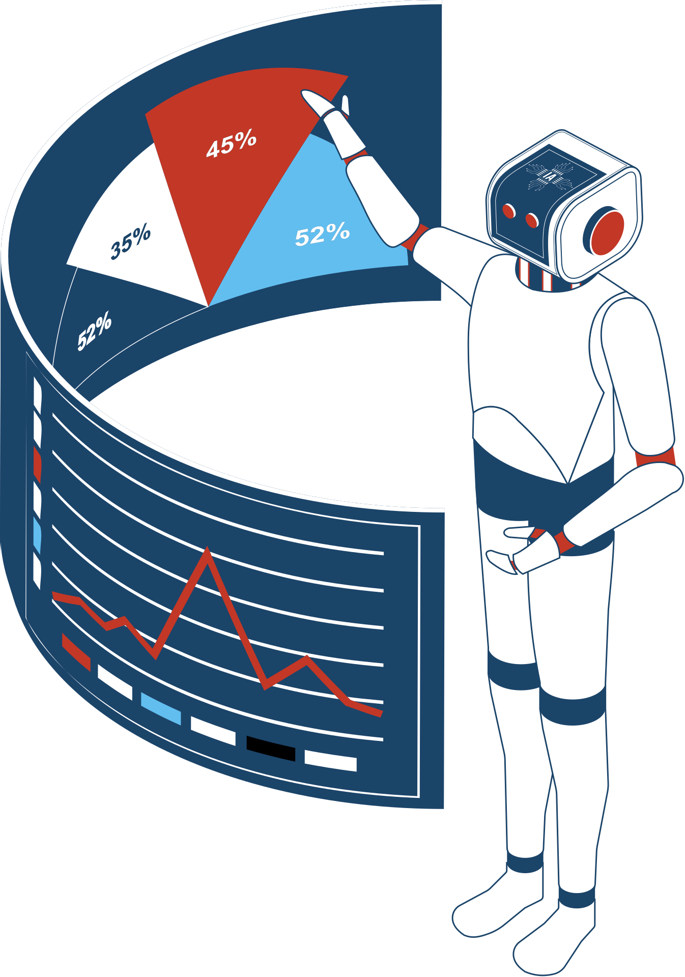
Clustering Models
K-Means Clustering
Hierarchical Clustering
DBSCAN (Density-Based Spatial Clustering)
Gaussian Mixture Models (GMM)

Slide 5

Association Models
Apriori Algorithm
Eclat Algorithm
FP-Growth Algorithm

Slide 6


Applications
Clustering
Customer Segmentation
Document Clustering
Social Network Analysis
Anomaly Detection
Association
Market Basket Analysis
Recommender Systems
Retail Analytics

